Slide 1
SAY NO TO CHILD LABOUR
NAME : PUPPLA HEMANTH ROLL NO : 21J41A7353 BRANCH: B.tech-AIML

Slide 2
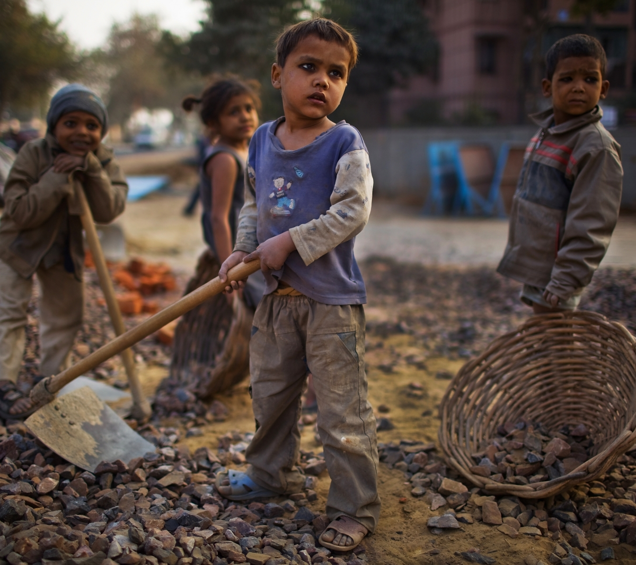
What is Child Labour ?
Interferes with their schooling. Depriving them of the opportunity to attend school.
Obliging them to leave school permanently.
The employment of children in an industry or business, especially when illegal or considered exploitative
The term “child labour” is often defined as work that deprives children of their childhood

Slide 3
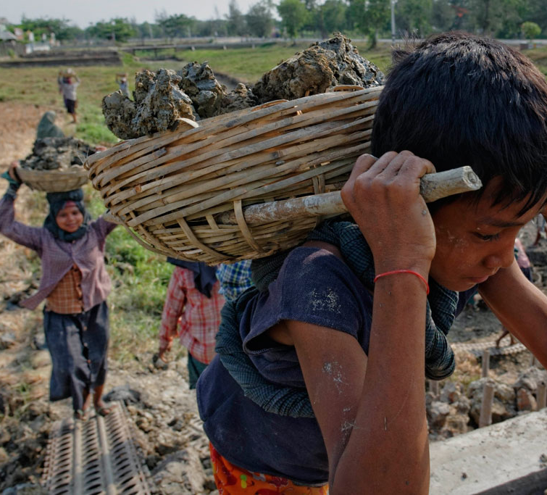
CAUSES OF CHILD LABOUR...
Child labour and exploitation are the result of many factors, including poverty, social norms condoning them, lack of decent work opportunities for adults and adolescents, migration and emergencies.
The main causes are :
Lack of access to quality education. ...
Poor access to decent work. ...
Limited understanding of child labour. ...
Natural disasters & climate change. ...
Conflicts & mass migration. ...
Fighting child labour.

Slide 4

CONSEQUENCES :
Health Effects. Child Labour at a fairly young age creates problems for children in the future with respect to health.
Denying of Education. The poor families deny education to their children because they send their children to work.
Poor Image of the Country. It is said that India has the largest number of child labourers in the.
Effects on Personality. Child labourers suffer from health problems. They remain illiterate and they do not get any...

Slide 5
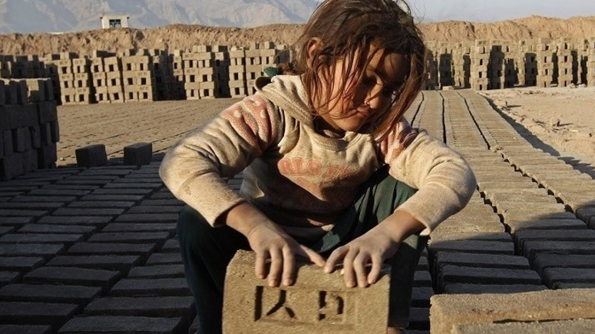
COUNTERACTING MEASURES:
Do your bit to stop it by making informed decisions and spreading awareness.
Stakeholders must take responsibility
Provide support for children
Improve economic growth for their family
Engage with the Sustainable Development Goals
Another option could be to build homes for those children that are living in the streets.
Prevention of racial discrimination

Slide 6
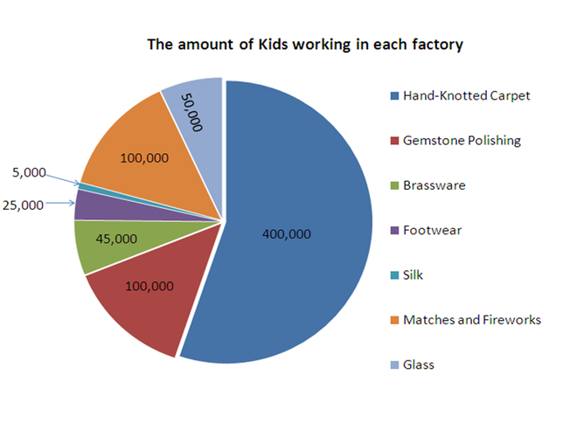
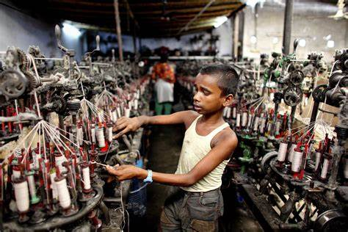
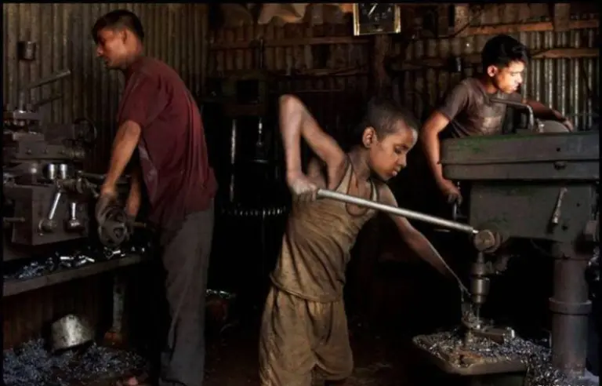
The Amount of kids working in each factory

Slide 7
Thank you.

